Slide 1
CHAPMAN UNIVERSITY HISTORY DEPARTMENT
2015-2016

Slide 2
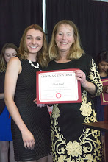
Phi Alpha Theta
Honor Society Awards
History Student Awards and Accomplishments
The Phi Alpha Theta, Alpha Mu Gamma has won the "Best Chapter Award" our first year in Division III. 7th Best Chapter awards in the past 8 years.
Voces Novae E-journal won the 2015 Gerald D. Nash History Journal Award for the best Undergraduate Electronic Journal in the nation. 5th win in past 7 years.
Top prizes in both Graduate & Undergraduate American History at the Southern California Regional Conference. UG: Maci Reed/GRAD: Lauren Cruz (1st MA win)
2015 SURF (Summer Undergraduate Research Fellowship) students from History: Fernie Amador, Jessica Paek, Abby Kim, and Alfredo Gonzalez.
Bijan Kazerooni, Kristine Avena, and Maci Reed awarded Undergraduate Student Scholarly Research/Creative Grants. Maci & Kristine traveled to Washington, D.C. and Bijan to London.
Amanda Larsh and Kyle Chronley have summer internships at the Richard Nixon Library.
Lauren Cruz won 1st in the John & Margaret Class Student Book Collection Contest. Kristine Avena won 3rd in the Kevin & Tam Ross Leatherby Libraries Undergraduate Research Prize contest.

Slide 3
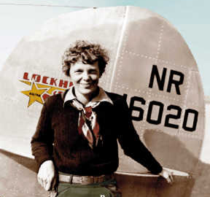
TRAVEL COURSE AND HISTORY ALUMNI NEWS
History Alumni News:
Jessica Torrico ’09, coordinating logistics for special events in the park, selected to participate in Emerging Leaders, a Disney management training program.
Kirsten Moore ’11, Nicole Swinford ‘13, and Marley McLaughlin ’14 have written eBooks thru the Paragon Agency. Nicole wrote on Amelia Earhart’s Last Photo Shoot and received national attention with live interviews with the Associated Press, Fox News and National Geographic.
Travel Course: Tale of Two Cities – Interterm 2016, with 40 students from History, French, and Comm., taught by Dr. Leland Estes and Dr. William Cumiford

Slide 4
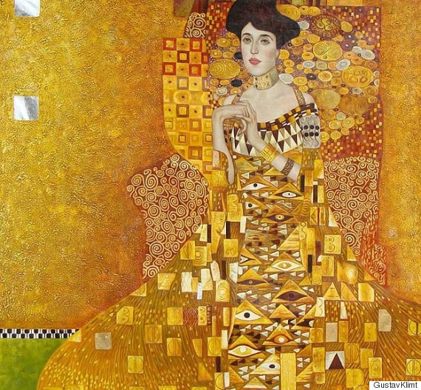
“Legacy of Heart Mountain”, with Panel Discussion, Co-sponsored with Sociology Rodgers Center – “Looted Art: Stealing cultural heritage,” with Panel discussion Opening of The Center for American War Letters “Howard Arthur Tibbs - Tuskegee Airman, jazz Musician” Evan Thomas – “The presidency at War” Andrew Bacevich – “Washington Rules”
Events & Guest Speakers

Slide 5
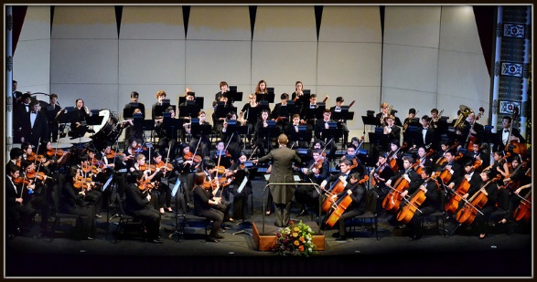
Leadership, grants, Guest Speakers, and research
Dr. Jennifer Keene installed as Vice President for the Society for Military History
Professor Brenda Farrington, Phi Alpha Theta advisor, two year appointment as a council member to the Phi Alpha Theta National Board
Dr. Robert Slayton awarded Wilkinson College Scholarly Subvention Funding Grant; Guest Speaker at World War II “End of the War” commemoration at Leatherby Library
Dr. Alexander Bay research travel to the East Asia Environmental Conference, American Society for Environmental History, and History of Science in the East
Dr. Shira Klein – Research presentation at Oxford University on “Holocaust Memory in Italy”
Dr. Jennifer Keene, guest speaker at the Disney Hall performance, on literary and musical perspectives of WWI

Slide 6
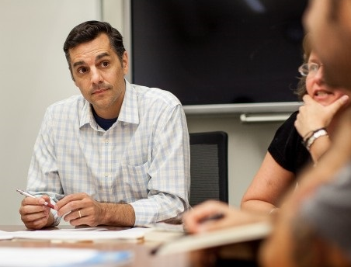
Selected Presentations and panel discussions
Panel Discussion on performance of Merchant of Venice: Venice, Jewish Ghetto and Heritage in Europe, and the character Shylock, moderated by Dr. Marilyn Harran and Dr. Shira Klein
Dr. Greg Daddis, Panel Commentator, at the Society for Military History 83rd Annual Meeting, Ottawa, Canada, and a Presenter at the Wisconsin Veterans Museum Distinguished Lecture Series in Madison, Wisconsin.
Dr. Shira Klein: Public talks: UCLA – “Why Italian Jews Liked Fascism”; Merage Jewish Community Center, Irvine – “How Jewish are Italian Jews?”
Dr. Greg Daddis, Panel Participant, “A War of Words: Academics & the Military Establishment in the Age of Terror”, American Historical Association Annual Meeting, Atlanta, Georgia

Slide 7
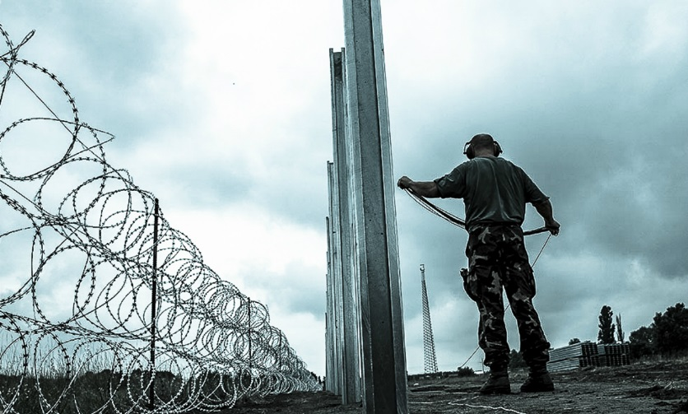
publications
Dr. Robert Slayton, “America’s First Illegal Immigrants”, Jewish Currents; Spring 2016
Dr. Shira Klein, “History Lessons Cast in Bronze”, Chapman Magazine, October 2015
Dr. Gregory Daddis, “Introduction” to Thomas C. Thayer, War Without Fronts: The American Experience in Vietnam”: Naval Institute Press, 2016
Blog Articles – Dr. Greg Daddis:
“Are Our Borders Better Than Your Borders?” War on the Rocks, October 2015.
“Afraid of Peace,” The National Interest, July/August 2015.
Selected Articles, Book Chapters, and Blogs

Slide 8
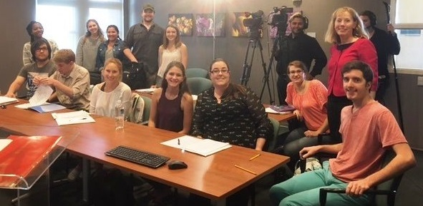
C-span events
Tour of Center for American War Letters with Rand Boyd
Tour of Barry & Phyllis Rodgers Center for Holocaust Education with Dr. Marilyn Harran
Lecture: Dr. Marilyn Harran use of Elie Wiesel Books in Holocaust studies
Lecture: Dr. Jennifer Keene presents WW1 – The Myth Buster Edition
Book Author Talk: Dr. Robert Slayton, “Empire Statesman” (Rise of Al Smith)
Book Author Talk: Dr. Jennifer Keene, “Dough Boys & The Great War”
Filming of Chapman Tours, Lectures, and Book Talks

Slide 9
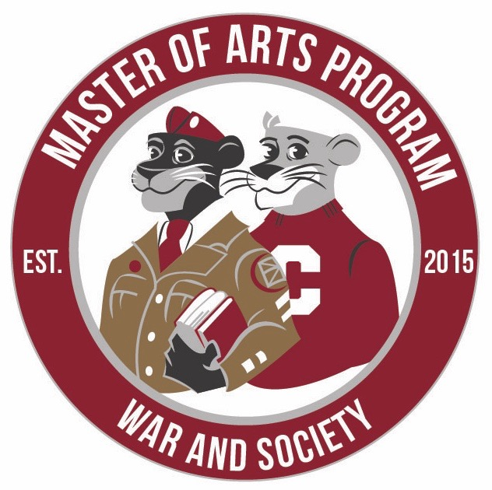
Masters in War & Society Program
First MA in War & Society Graduate – Andrew Harman
First +1s from the 4+1 Program to begin MA classes
Five 2nd years and 6 new 1st year students in program
MA program doubles in size from first year!
The Center for American War Letters new home in the lower level of the Leatherby Libraries along with an Archives Reading Room study area.
Special visitor to CAWL: William D. Adams, Chairman of the National Endowment of the Humanities (NEH) learns about our MA Program.

Slide 10
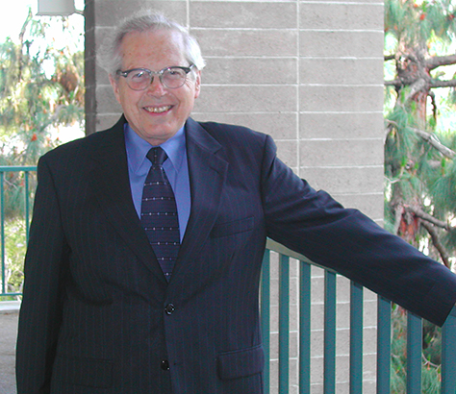
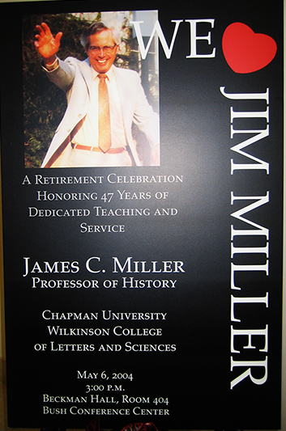
HISTORY DEPARTMENT 2015-16
And a final farewell to Jim Miller aka “Killer Miller”
who passionately taught at Chapman for 47 years.
Thank you, Professor.
In Memorium: James C. Miller, Professor Emeritus
July 13, 1927-November 11, 2015

